Slide 1
Interference-Aware Spectrum Sensing and Sharing in Cognitive Network

Slide 2
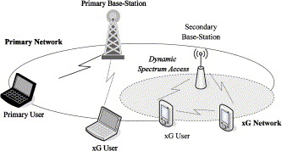
Cognitive Network
Primary user / secondary user

Slide 3

Interference-aware spectrum sensing
Detection threshold $θ$
Spectrum hole discovery
$P_{SHD}=P_{E}P_{MD}\left(1−P_{I}\right)+\left(1−P_{E}\right)\left(1−P_{FA}\right)$
Constraint
$P_{MD}P_{I}≤ε$

Slide 6
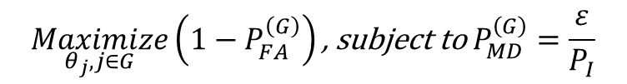
Cooperative spectrum sensing
Decision fusion
Soft (EGC, MRC)
Hard (OR, AND)
problem
$$\underset{θ_{j},j∈G}{Maximize}\left(1−P_{FA}^{\left(G\right)}\right)\text{, }\text{subject} \text{to} P_{MD}^{\left(G\right)}=\frac{ε}{P_{I}}$$

Slide 9
Coalition Formation
Decision voting
problem

Slide 10
Coalition formation proposition
Bound by Pi
Independent of Coalitions
Depends only on members in the coalition
Orderly search
From layer 1, 2, |V|, |V|-1, ... , 4, 3
Contiguous coalition
Given i, j, k and , j would like to join {i, k}

Slide 12
CS_opt
[1x4 double] [1x3 double]
[1x3 double] [1x2 double] [1x2 double]
[1x2 double] [1x2 double] [5] [6] [7]
[1x2 double] [3] [4] [5] [6] [7]
[1x2 double] [3] [4] [5] [6] [7]
[1x2 double] [3] [4] [5] [6] [7]
[1x2 double] [3] [4] [5] [6] [7]
[1x2 double] [3] [4] [5] [6] [7]
[1x2 double] [3] [4] [5] [6] [7]
[1x2 double] [3] [4] [5] [6] [7]

